Slide 1
Linear Algebra
Lecture 35

Slide 2
Linear Algebra
Lecture 35

Slide 3
Eigenvalues and
Eigenvectors

Slide 4
Iterative Estimates
for Eigenvalues

Slide 5
Power
Method

Slide 6


Let a matrix A is diagonalizable, with n linearly independent eigenvectors, v₁, …, v_{n}, and corresponding Eigen-values
…

Slide 7
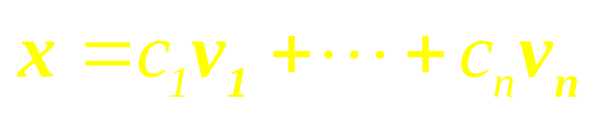
Since { v₁, …, v_{n} } is a basis for R^{n}, any vector x can be written as
…

Slide 8
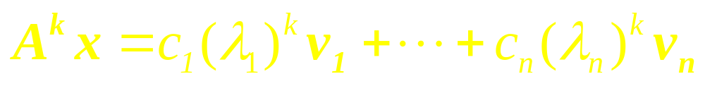

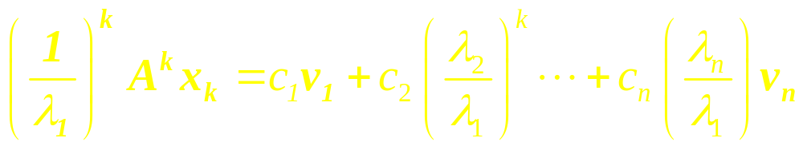
…

Slide 9


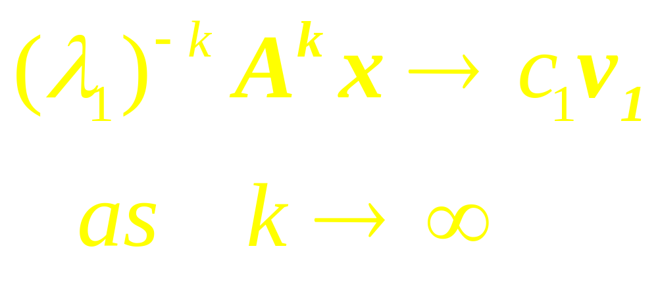

Slide 10
Thus for large k, a scalar multiple of A^{k}x determines almost the same direction as the eigenvector c₁v₁. Since positive scalar multiples do not change the direction of a vector, A^{k}x itself points almost in the same direction as v₁ or –v₁, provided c₁ 0.

Slide 11
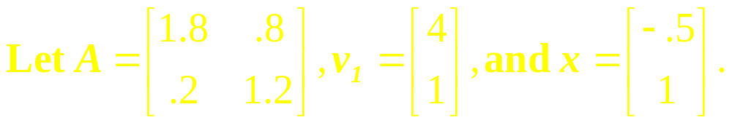
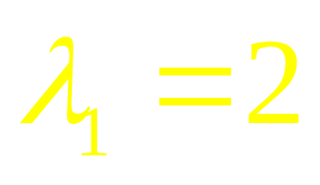
Example 1
Then A has eigenvalues 2 and 1, and the eigenspaces for is the line through 0 and v₁.
…

Slide 12
Continued
For k = 0, …, 8, compute A^{k}x and construct the line through 0 and A^{k}x. What happens as k increases?

Slide 13
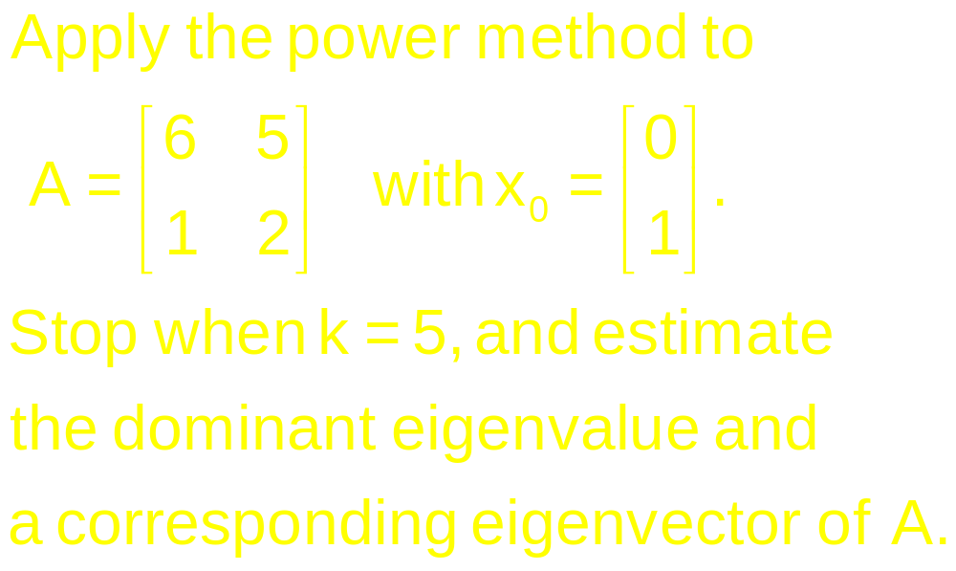
Example 2

Slide 14
Inverse
Power
Method

Slide 15
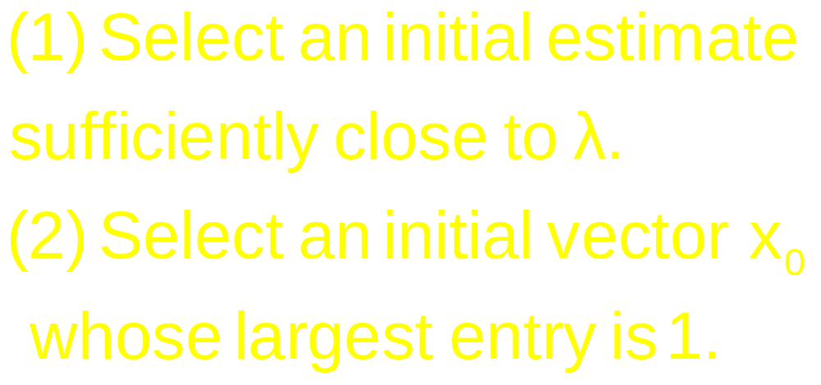
The Method
…

Slide 16
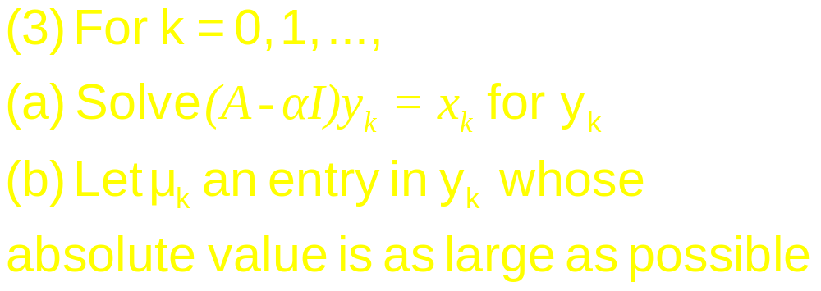
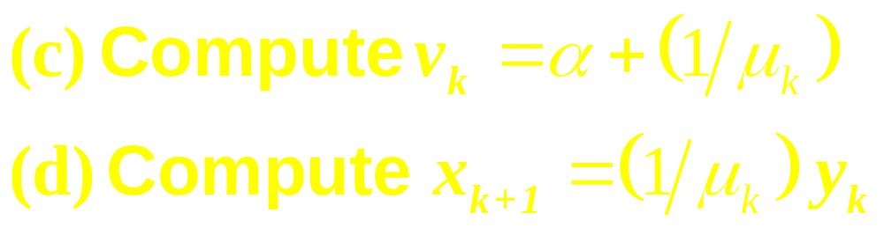
Continued
…

Slide 17

Continued
(4) For almost all choice of x₀, the sequence {v_{k}} approaches the Eigen-value of A, and the sequence {x_{k}} approaches a corresponding Eigen-vector

Slide 18
Example 3

Slide 19
Example 4
How can you tell if a given vector x is a good approximation to an eigenvector of a matrix A; if it is, how would you estimate the corresponding eigenvalue?
…

Slide 20
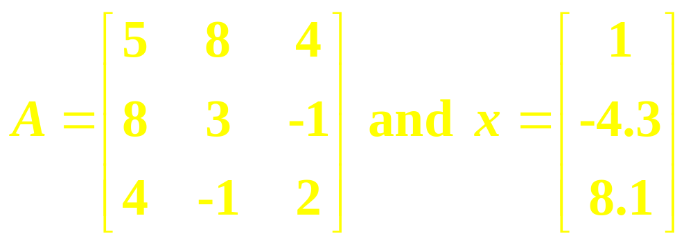
Continued
Experiment with

Slide 21
Revision
(Segment V)

Slide 22

Definition
If A is an n x n matrix, then a scalar is called an eigenvalue of A if there is a nonzero vector x such that Ax = x.
…

Slide 23
Continued
If is an eigenvalue of A, then every nonzero vector x such that Ax = x is called an eigenvector of A corresponding to .

Slide 24
Theorem
If A is an n x n matrix and is a scalar, then the following statements are equivalent.
(i) is an eigenvalue of A.
…

Slide 25

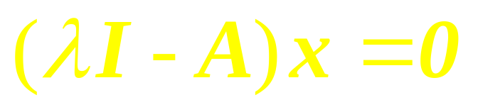
Continued
(ii) is a solution of the equation
(iii) The linear system
has nontrivial solutions.

Slide 26
Theorem
If A is a triangular matrix (upper triangular, lower triangular, or diagonal) then the eigenvalues of A are the entries on the main diagonal of A.

Slide 27

Theorem
If is an eigenvalue of a matrix A and x is a corresponding eigenvector, and if k is any positive integer, then is an eigenvalue of A^{k} and x is a corresponding eigenvector.

Slide 28

Characteristic
Equation

Slide 29
Similarity
If A and B are n x n matrices, then A is similar to B if there is an invertible matrix P such that P ⁻¹AP = B, or equivalently, A = PBP ⁻¹.
…

Slide 30
Similarity
Writing Q for P ⁻¹, we have Q ⁻¹BQ = A.
So B is also similar to A, and we say simply that A and B are similar.

Slide 31
Theorem
If n x n matrices A and B are similar, then they have the same characteristic polynomial and hence the same eigenvalues (with the same multiplicities).

Slide 32
Diagonalization

Slide 33
Remark
A square matrix A is said to be diagonalizable if A is similar to a diagonal matrix. i.e. if A = PDP ⁻¹ for some invertible matrix P and some diagonal matrix D.

Slide 34
Diagonalization Theorem
An n x n matrix A is diagonalizable if and only if A has n linearly independent eigenvectors.

Slide 35
Theorem
An n x n matrix with n distinct eigenvalues is diagonalizable.

Slide 36
Eigenvectors
and Linear
Transformation

Slide 37
Matrix of LT
Let V and W be n-dim and m-dim spaces, and T be a LT from V to W.
To associate a matrix with T we chose bases B and C for V and W respectively
…

Slide 38
continued
Given any x in V, the coordinate vector [x]_{B} is in R^{n} and the [T(x)]_{C} coordinate vector of its image, is in R^{m}
…

Slide 39
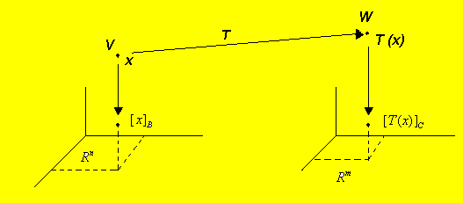

Slide 40
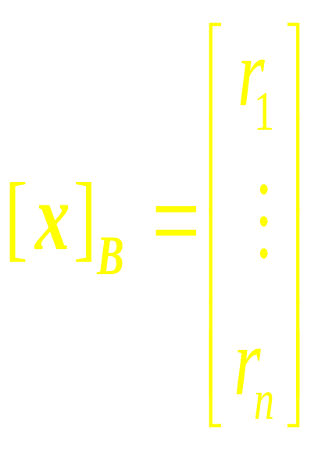
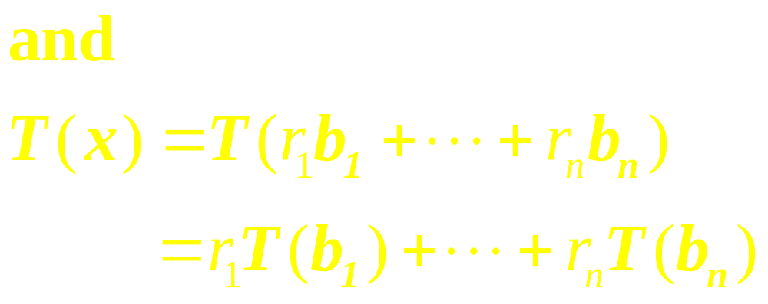
Connection between
[ x ]_{B} and [T(x)]_{C}
Let {b₁ ,…,b_{n}} be the basis B for V.
If x = r₁b₁ +…+ r_{n}b_{n}, then
…

Slide 41

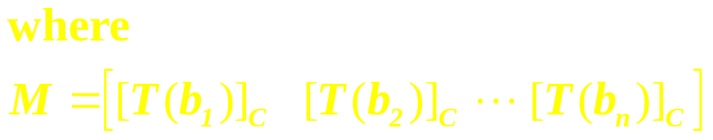
This equation can be written as

Slide 42
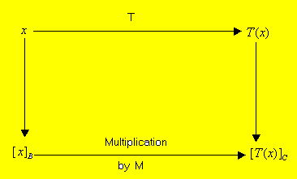
The Matrix M is the matrix representation of T, Called the matrix for T relative to the bases B and C

Slide 43
LT from V into V
When W is the same as V and the basis C is the same as B, the matrix M is called the matrix for T relative to B or simply the B-matrix

Slide 44
Linear Algebra
Lecture 35

Slide 45
Similarity of Matrix
Representations

Slide 46
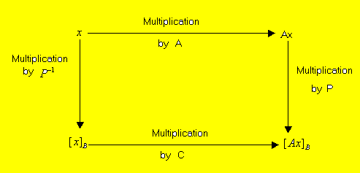
Similarity of two matrix
representations: A=PCP⁻¹

Slide 47
Complex
Eigenvalues

Slide 48


Definition
A complex scalar satisfies
if and only if there is a nonzero vector x in C^{n} such that We call a (complex) eigenvalue and x a (complex) eigenvector corresponding to .

Slide 49

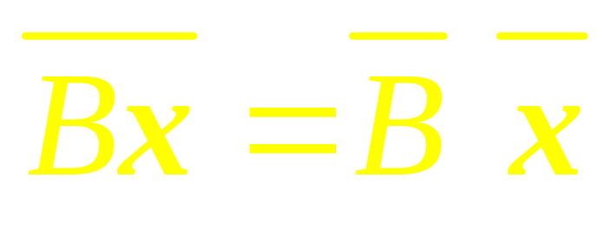
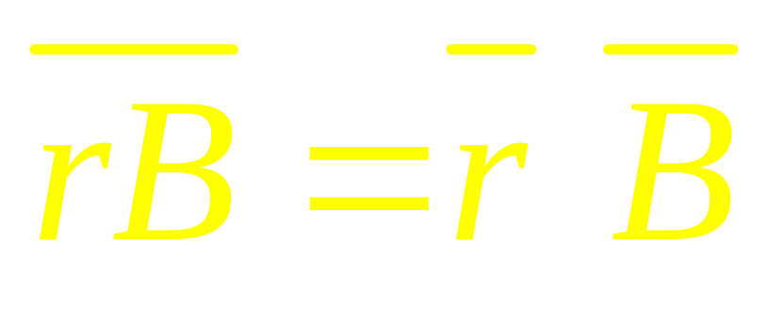
Note that

Slide 50
Discrete
Dynamical
System

Slide 51
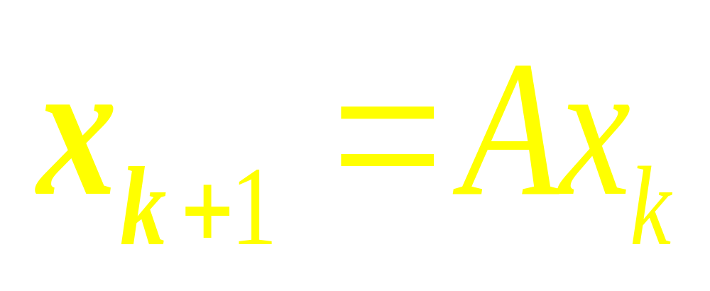

Slide 52
Note
If A has two complex eigenvalues whose absolute value is greater than 1, then 0 is a repellor and iterates of x₀ will spiral outward around the origin.
…

Slide 53
Continued
If the absolute values of the complex eigenvalues are less than 1, the origin is an attractor and the iterates of x₀ spiral inward toward the origin.

Slide 54
Applications to
Differential
Equations

Slide 55

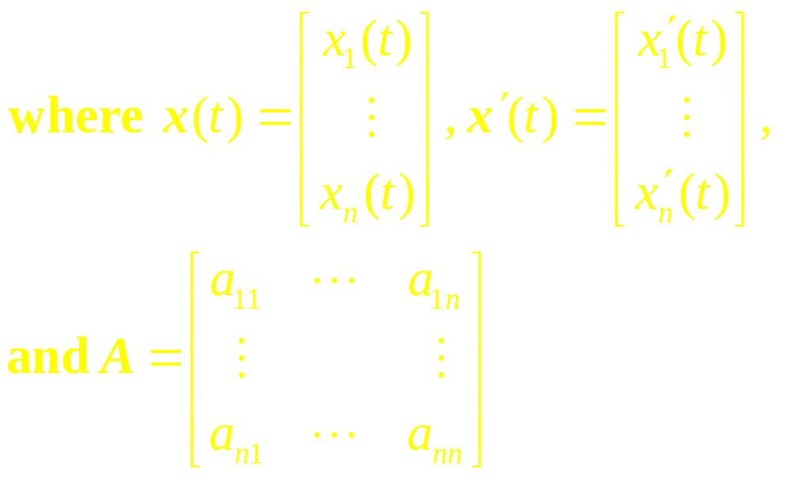
System as a Matrix
Differential Equation

Slide 56
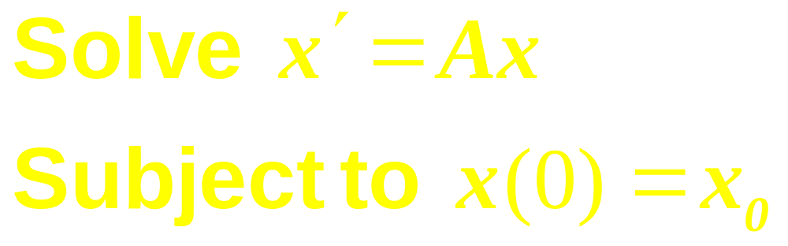
Initial Value
Problem

Slide 57
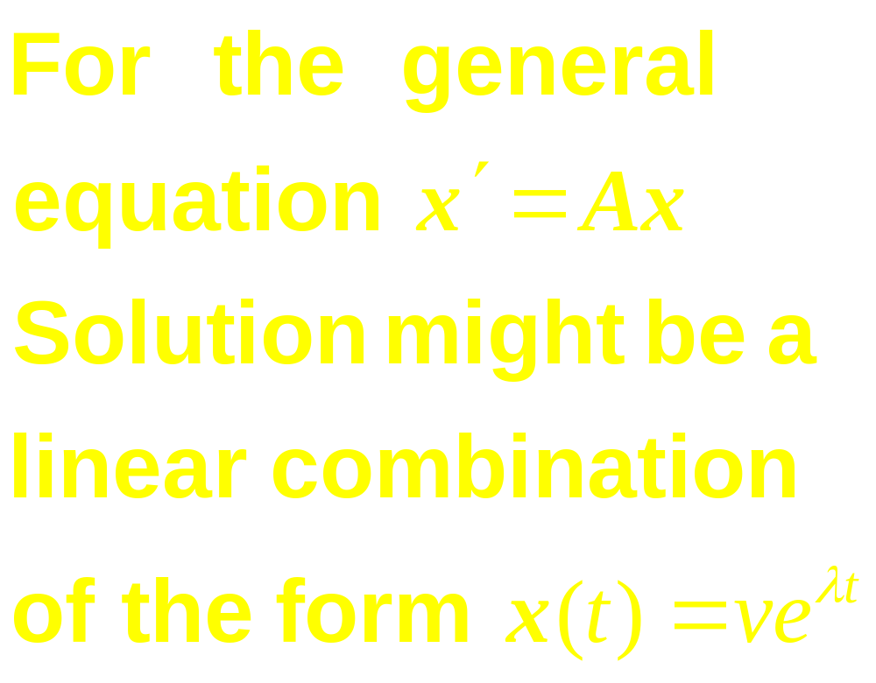
Observe
…

Slide 58
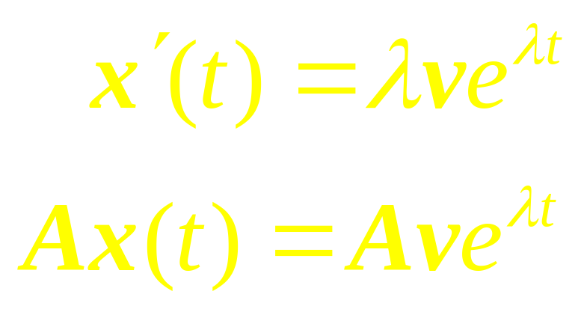
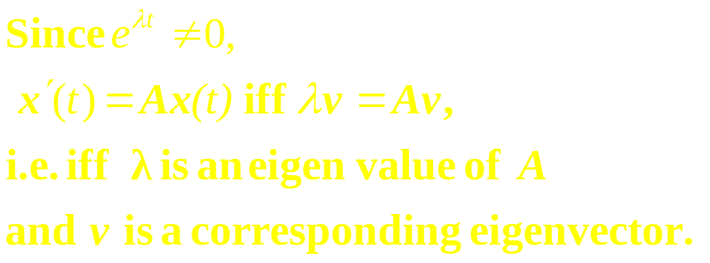
…

Slide 59
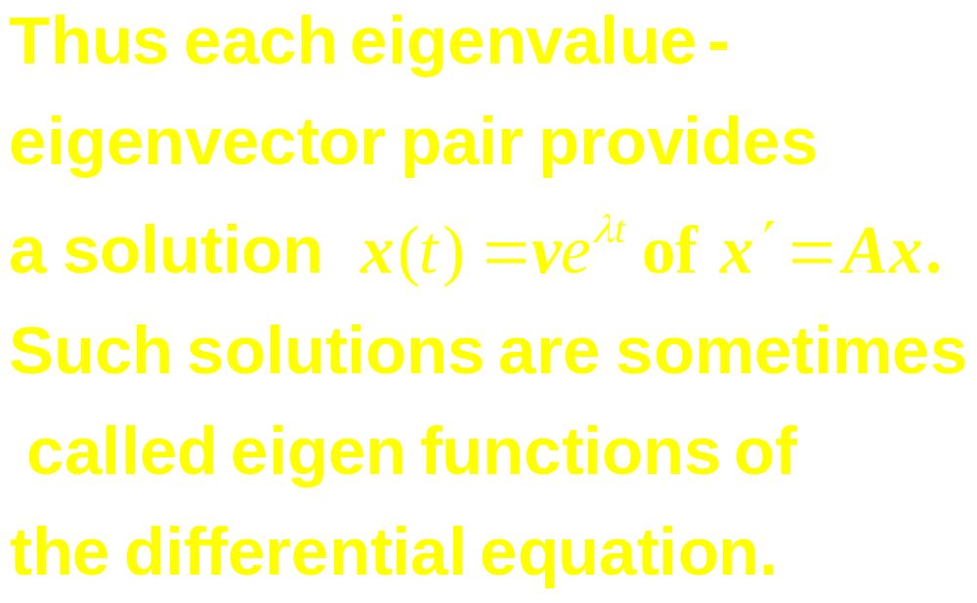

Slide 60
Linear Algebra
Lecture 35

